Slide 1
From theory to practice
Running a PET analysis (without programming) on vantage6
🙋‍♀️🙋‍♂️
Please interrupt me if you have a question!

Slide 2
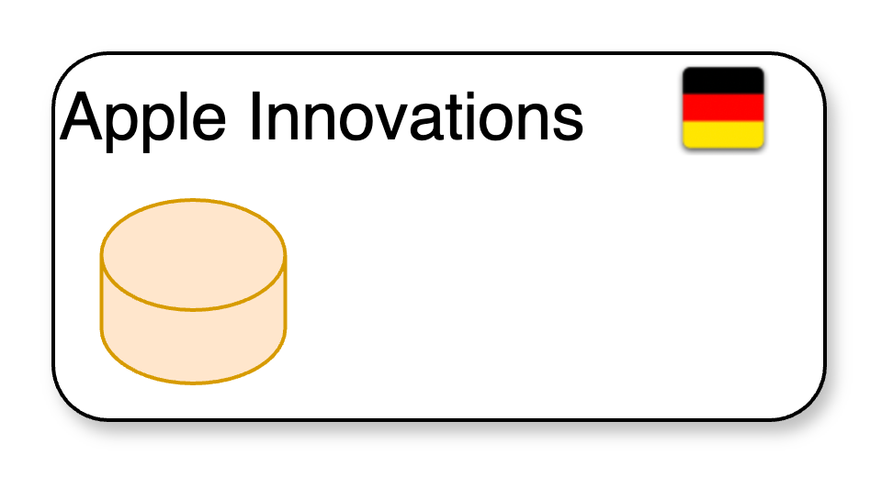
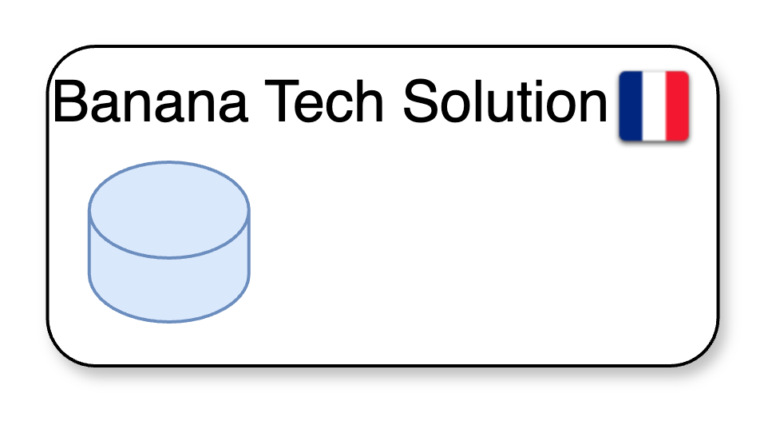
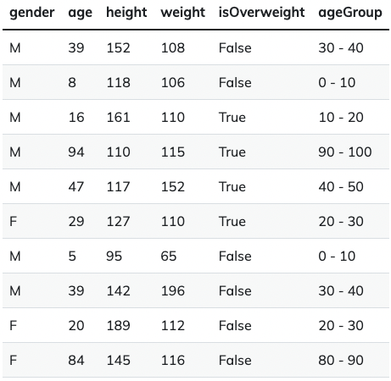
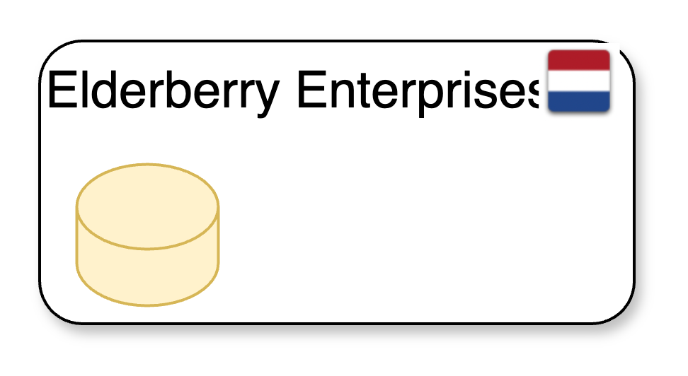
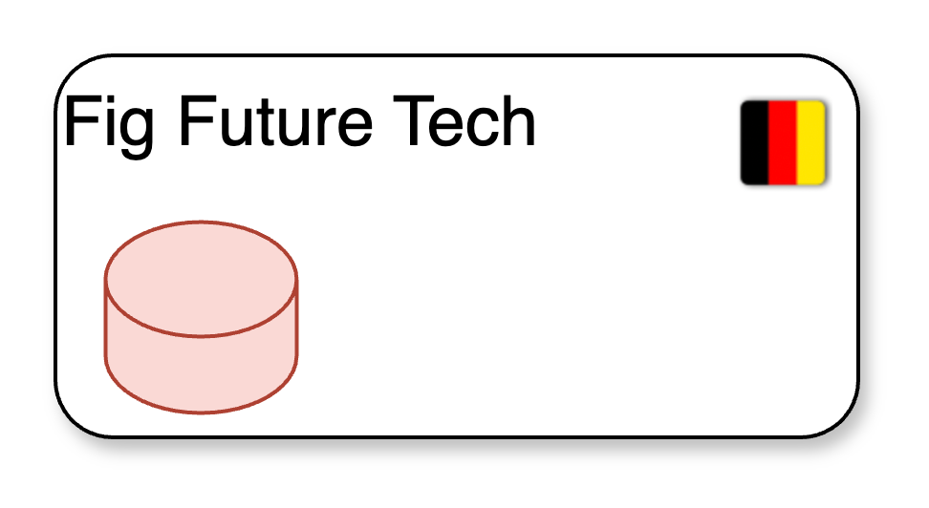
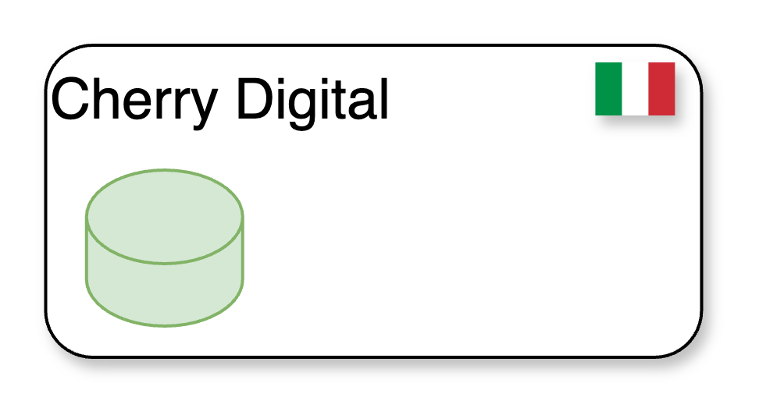
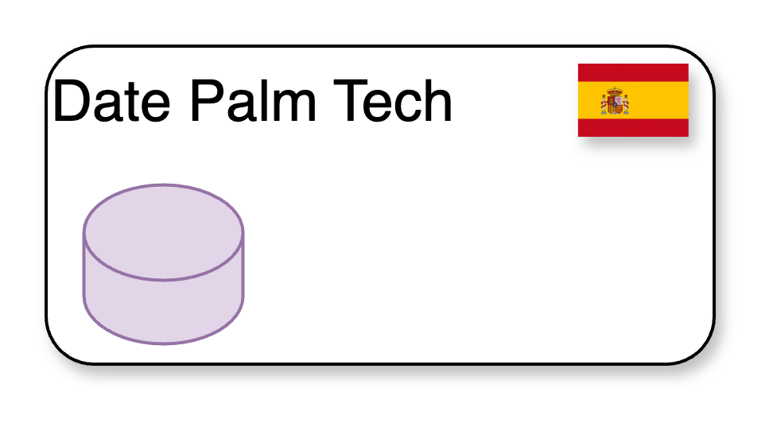
A theoretical scenario
An international consortium of research organizations working together on aging research.

Slide 3
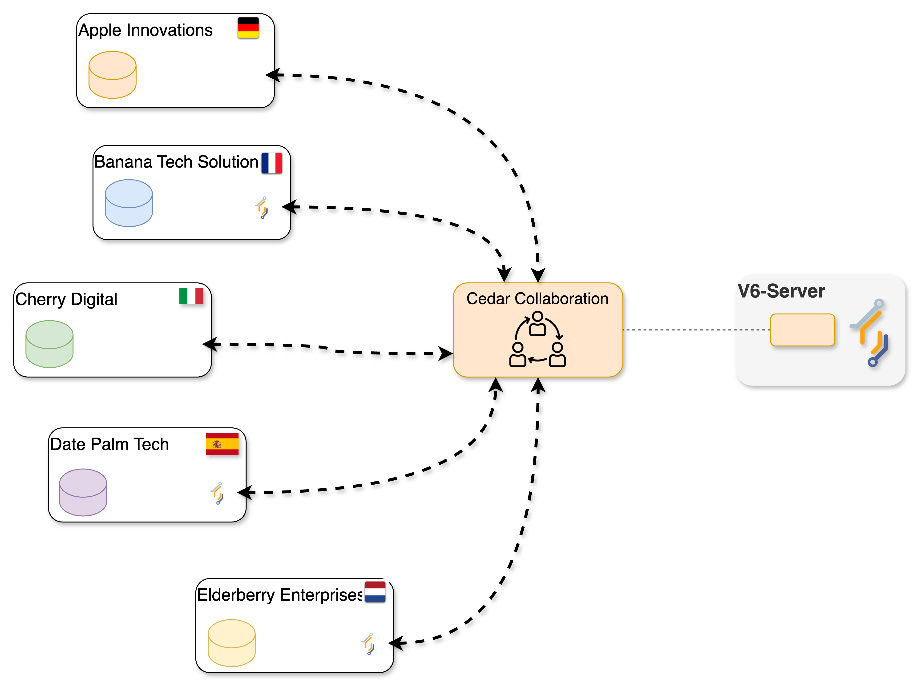

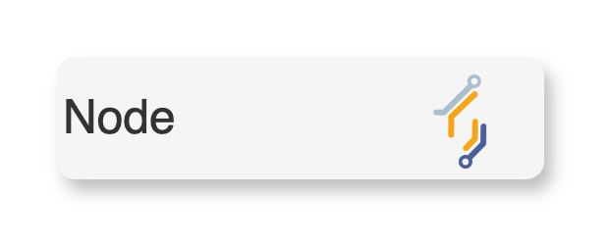
The scenario – checking v6 concepts!
Six organizations, one collaboration.
How many nodes need to be set up?
Where are these nodes installed?

Slide 4
The scenario – checking v6 concepts!
The consortium (from now on also referred as the collaboration) will initially focus on two different projects, each one involving different organizations:
Age-Related Variations in Overweight Prevalence: A Comparative Analysis Across Gender and Age Groups (AGOT2024) : four organization with relevant data.
The Effect of Gender on Height Development Across Various Age Groups (GGA2024): three organization with relevant data.
Which V6 concept is applicable here?

Slide 5
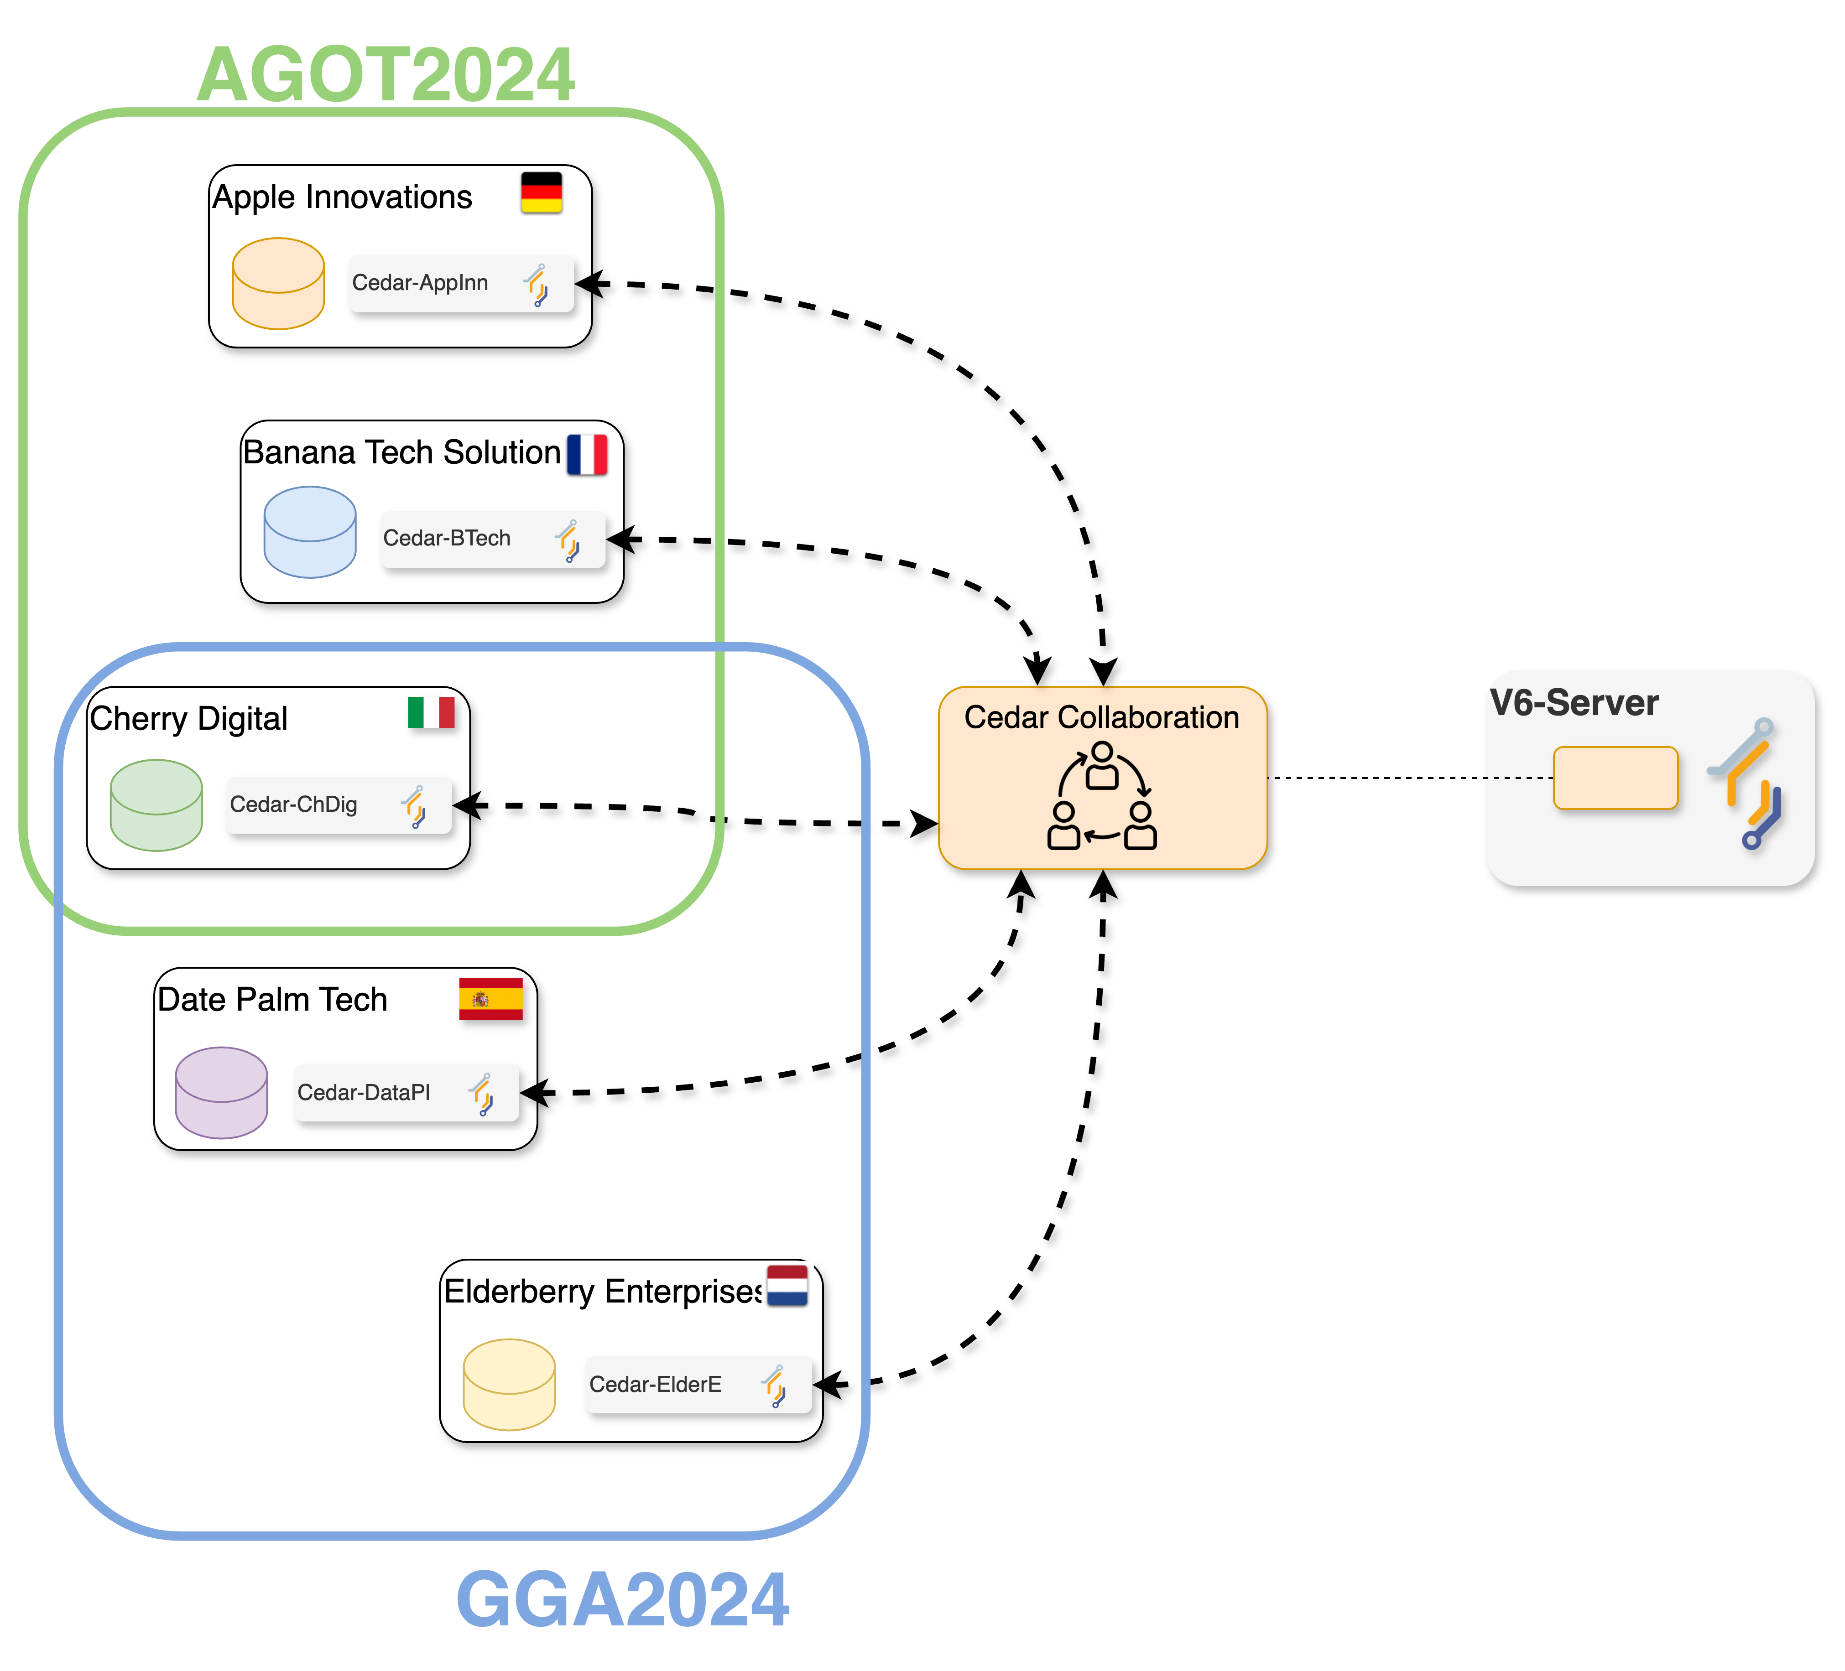
The scenario – checking v6 concepts!
Two studies: GGA2024, AGOT2024.
Your setup may be different!

Slide 6
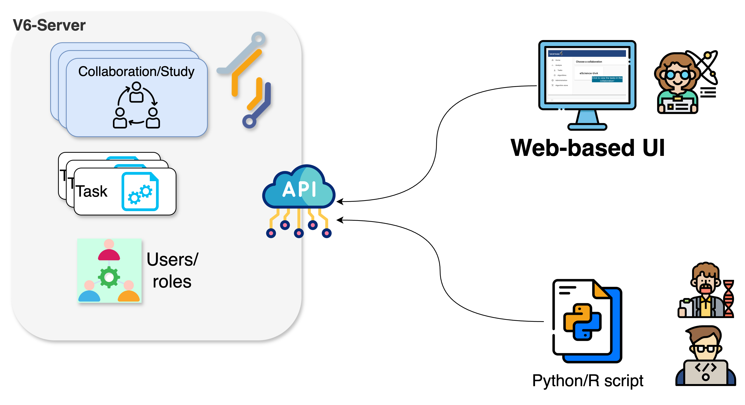
How to conduct an analysis?

Slide 7
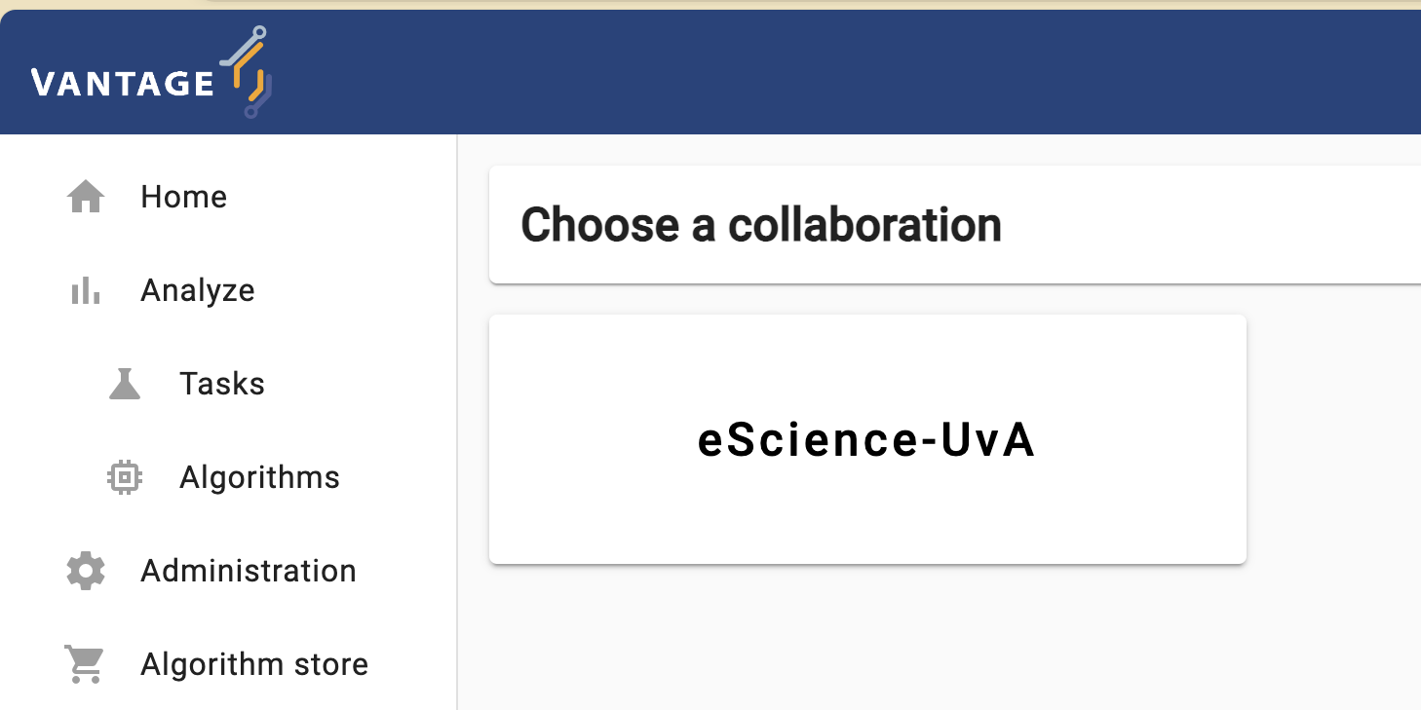
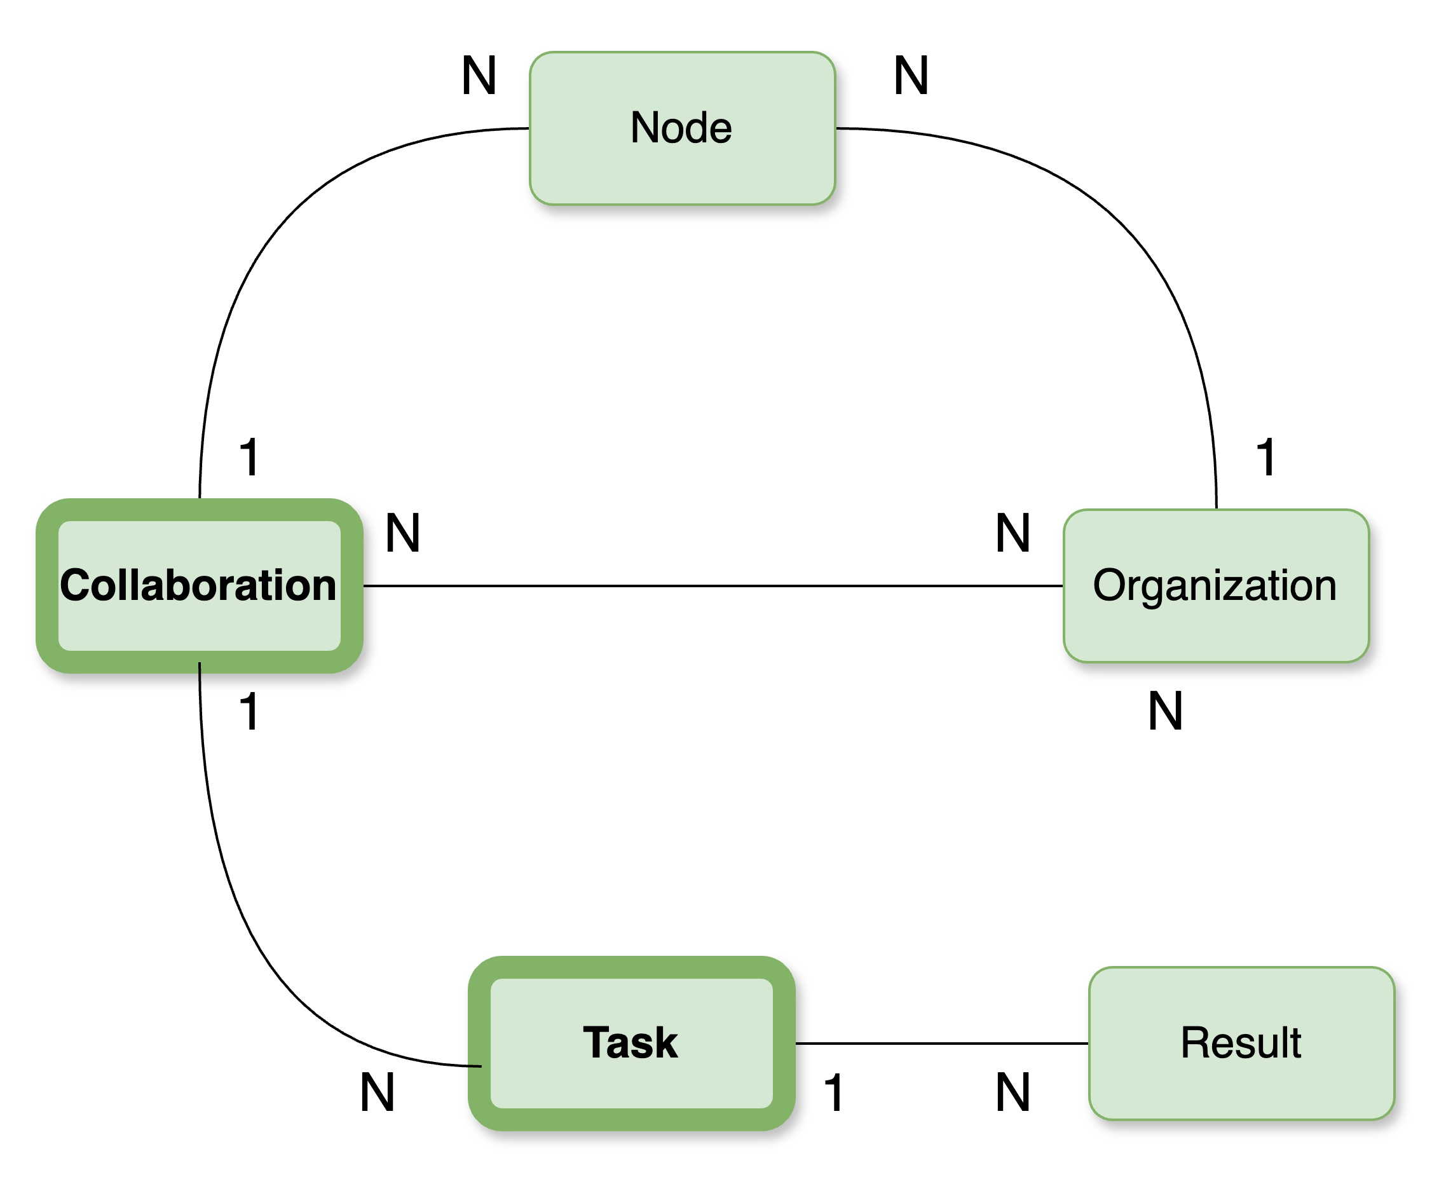
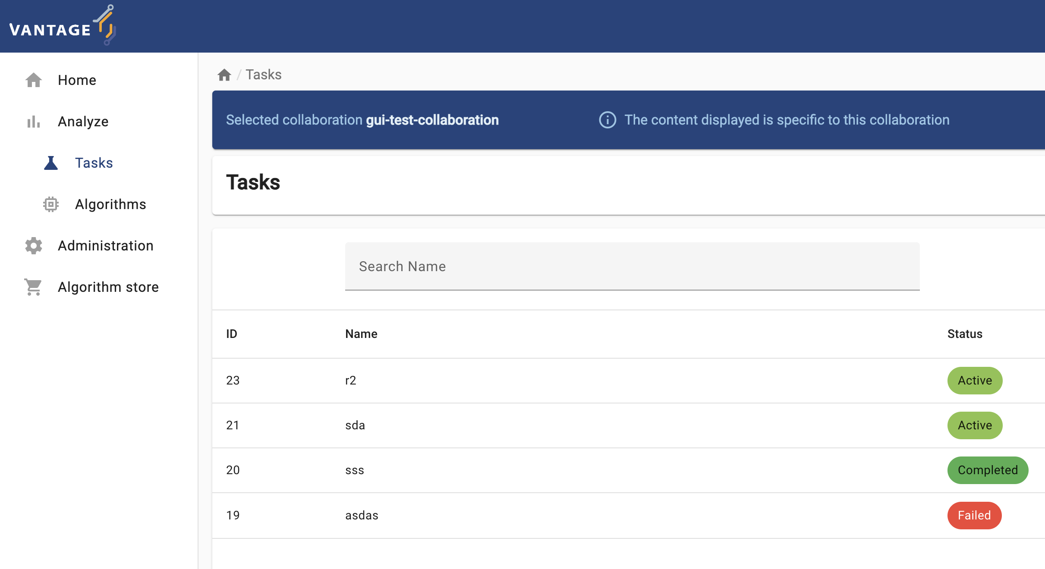
In this episode: web-based UI

Slide 8
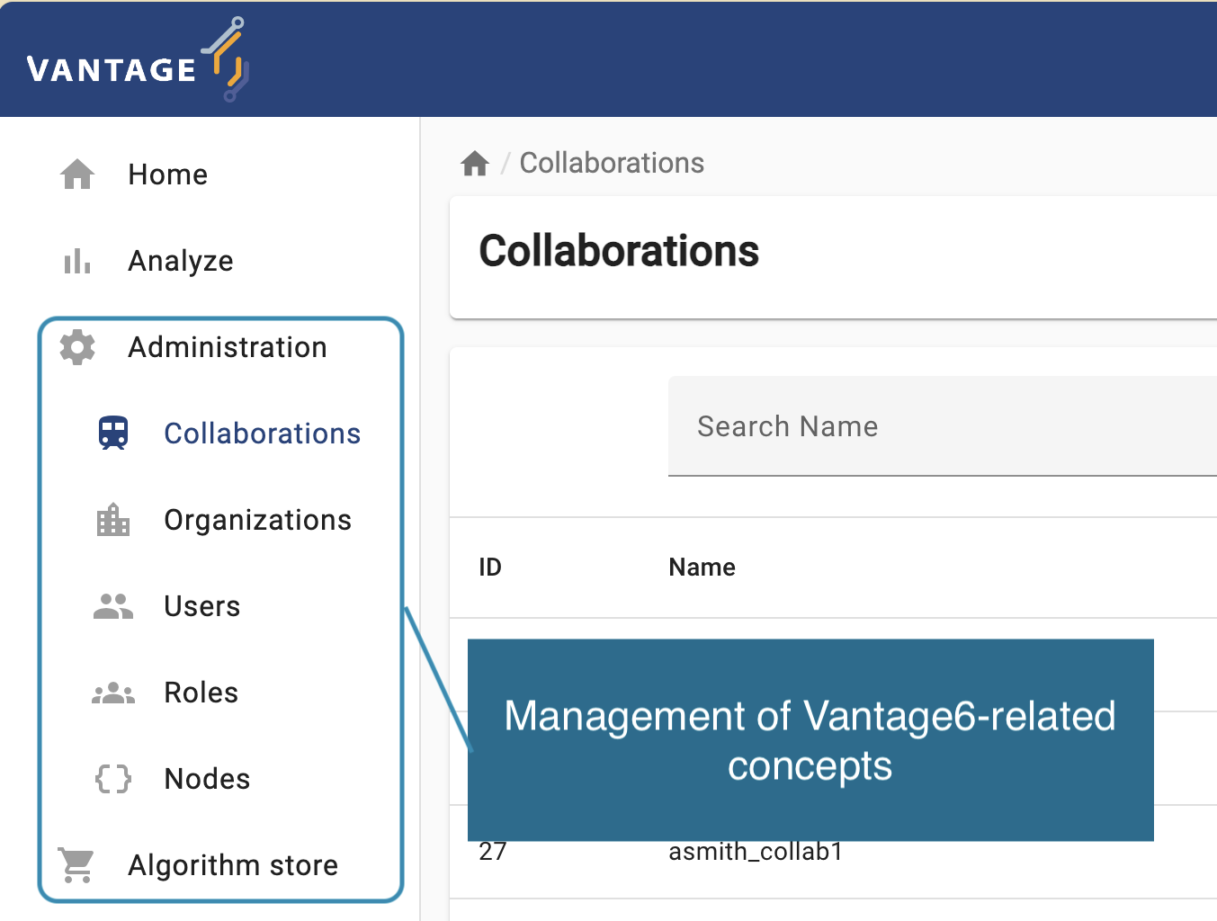
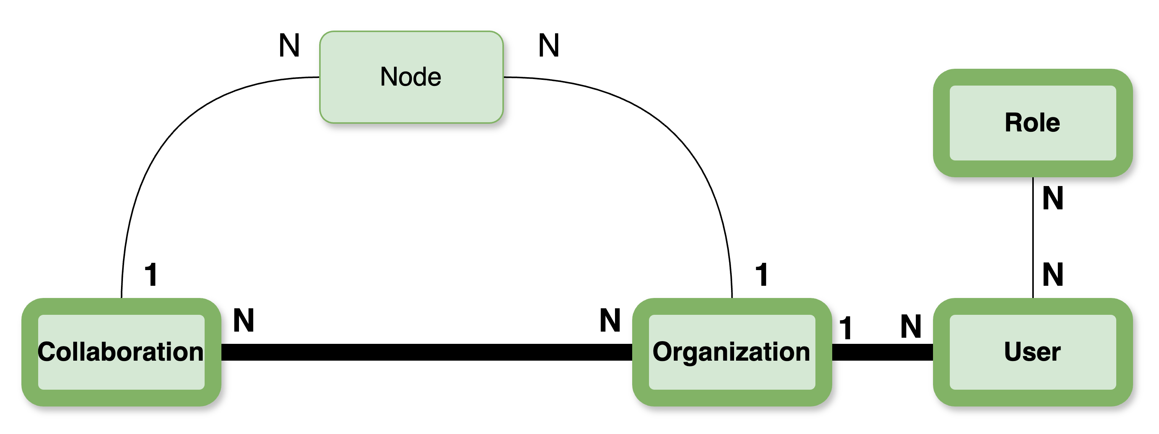
Web-based UI

Slide 9

Getting familiar with the UI
CHALLENGE 1
Log into the UI using the information provided and navigate to the administration page. Then, update your email, first name, and last name.
HINT Use the Users option on the Administration panel on the left.

Slide 10
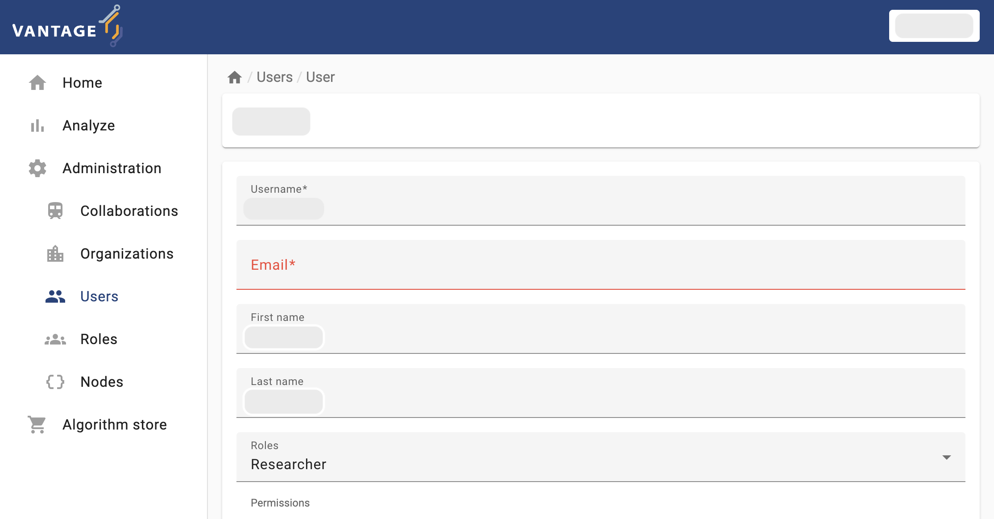
Getting familiar with the UI
SOLUTION

Slide 11


Running a PET: federated analysis
Are the nodes on my collaboration or study ready for a federated analysis?
Node within a collaboration: autonomously managed by its corresponding organization.
Some could be offline.
UI is handy for checking this!

Slide 12
Running a PET: federated analysis
CHALLENGE 2
With your researcher credentials, explore the collaboration you have access to. Check which organizations are part of it and if they are online. Then, check which organizations were assigned to each study: AGOT2024, GGA2924.
Which study is ready for a federated analysis?
If you need to perform an analysis for the study that is not ready, which organization you would need to contact to fix this situation?
* Take note of which Study is not ready, and the name of the ‘offline’ organization.
HINT Use the Collaborations option on the Administration panel on the left.

Slide 13
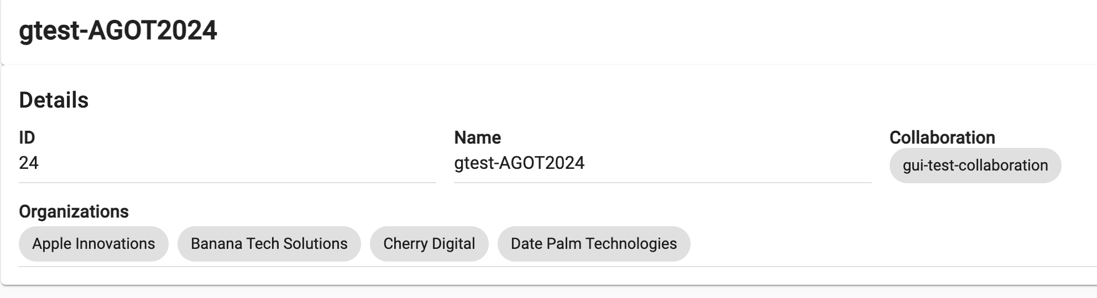
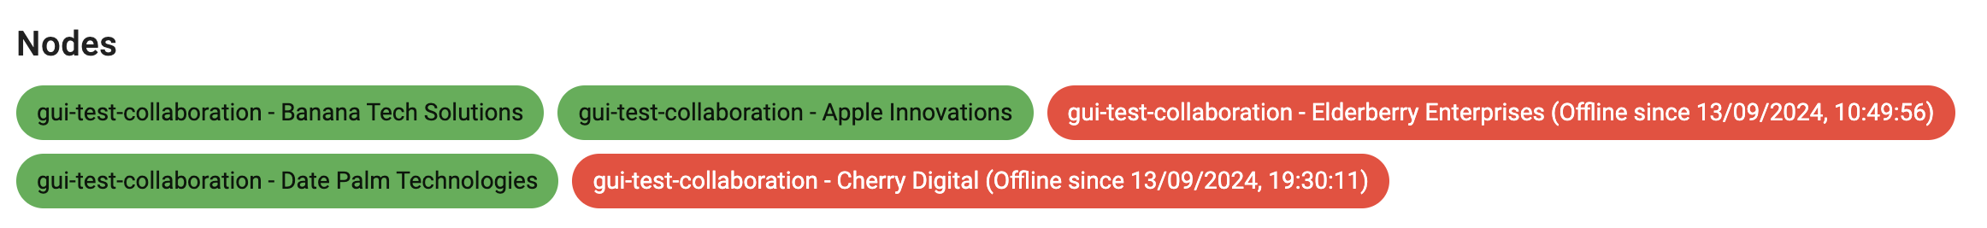

Getting familiar with the UI
SOLUTION

Slide 14
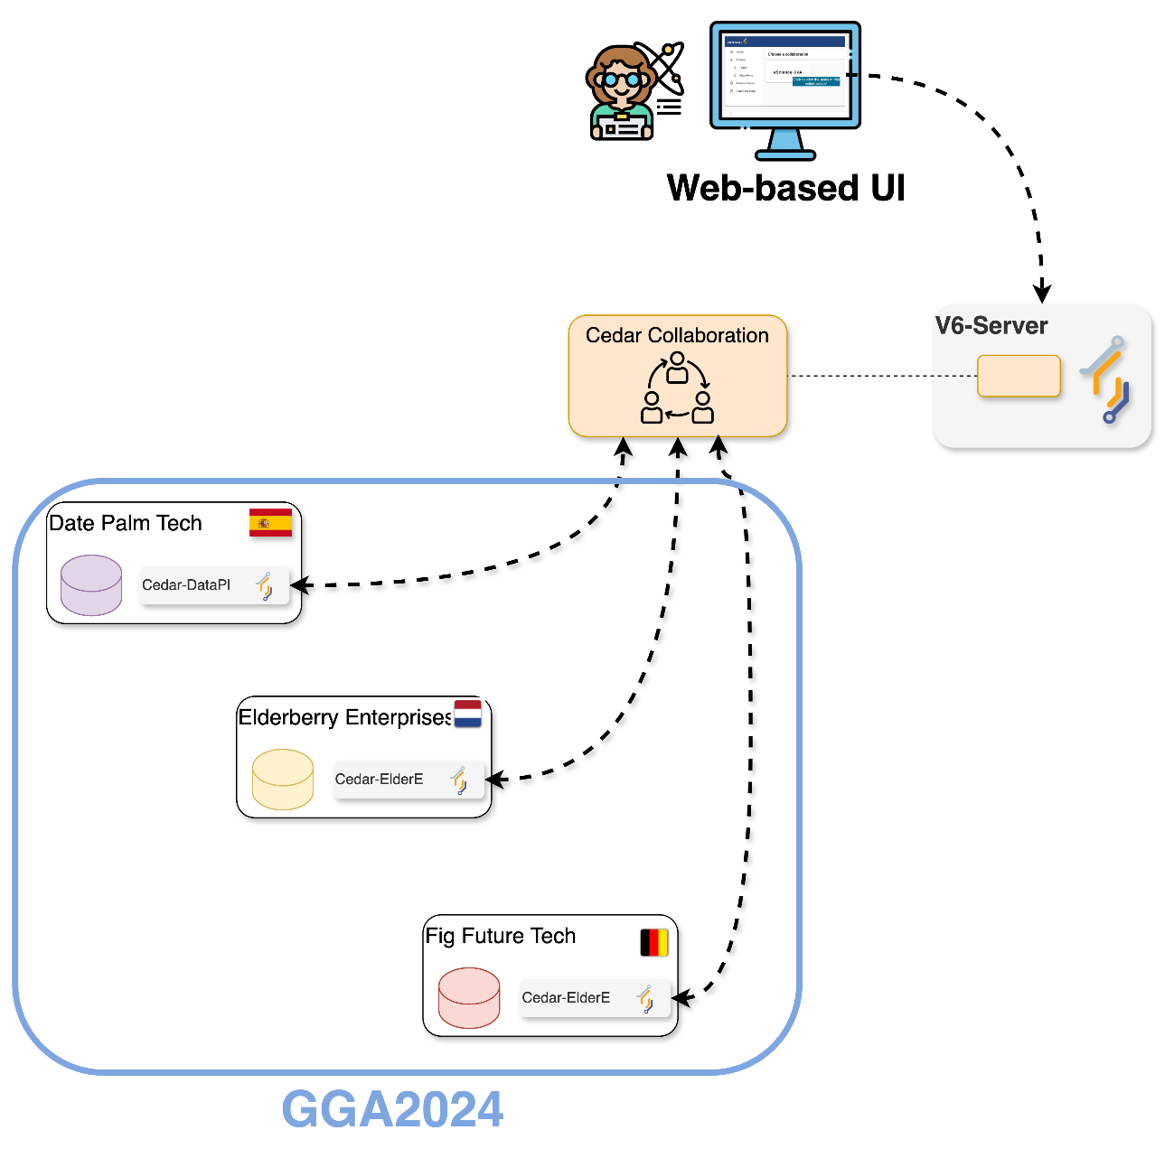

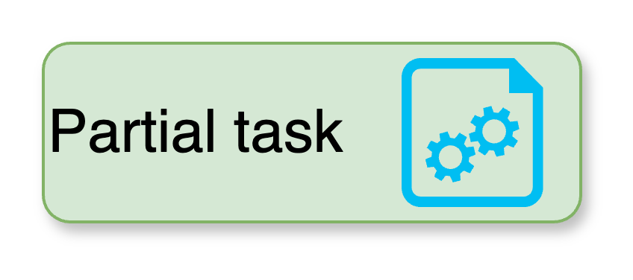
Running a PET: federated analysis
Federated
Average
Creating a new task:
You will run the partial_average function, of the Federated Average algorithm, on all the nodes of a study (the one with no offline nodes).
central_avg()
partial_avg()
Task request
(partial_average)
@all study nodes
Algorithm store

Slide 15
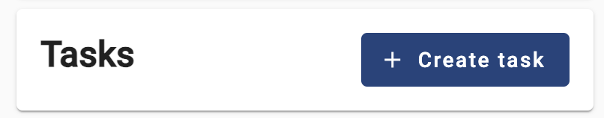
Running a federated algorithm
CHALLENGE 3
Create your first task!
Use the study with no offline nodes.
Give your own name to the task so you can find it later.
Choose the Average algorithm.
Select the partial_average function and all the organizations within the study.
Choose the default database.
Choose a numerical variable as the input.
The task you just requested should be listed with a ‘pending’ status. Once finished, download the JSON results and open them on a text editor.
What does the content of these files mean? Why the results are formatted like that?
HINT The data on ‘default’ databases on all the nodes looks like this ☝️.

Slide 16
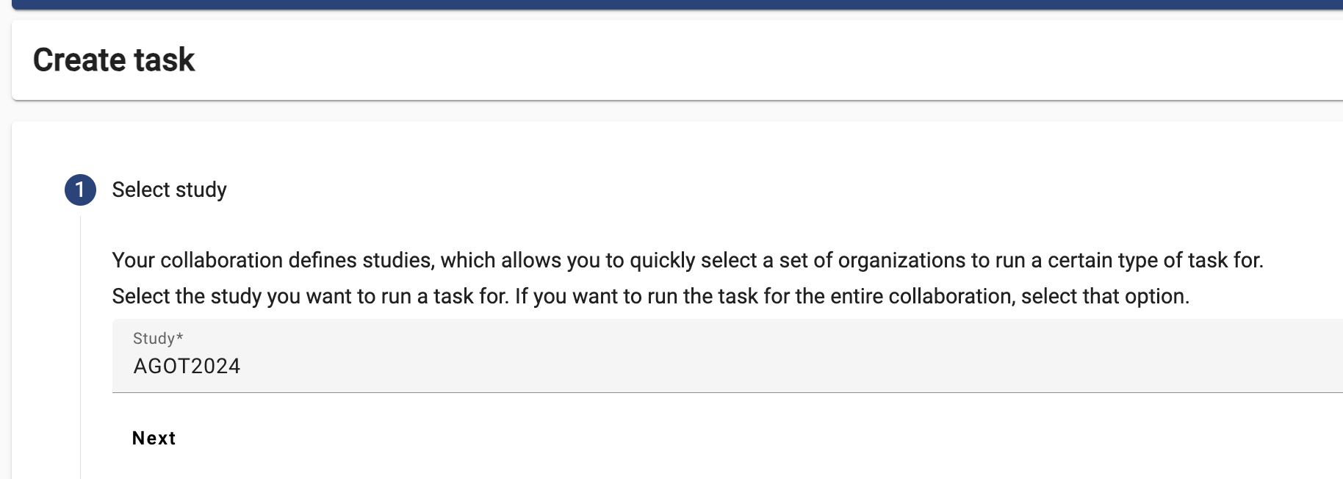
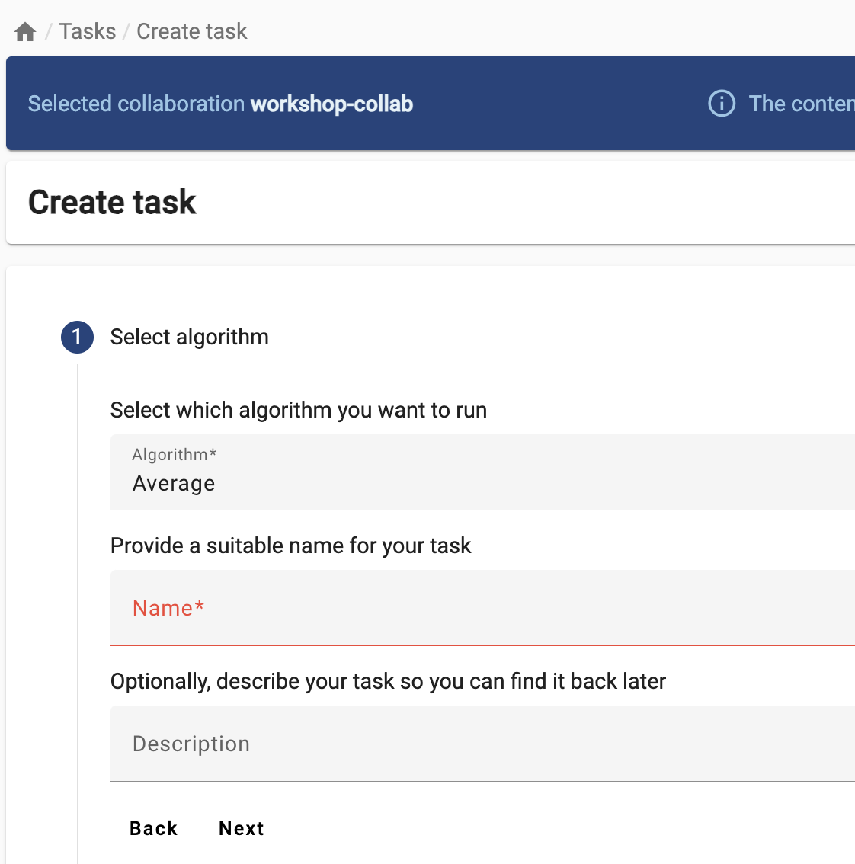
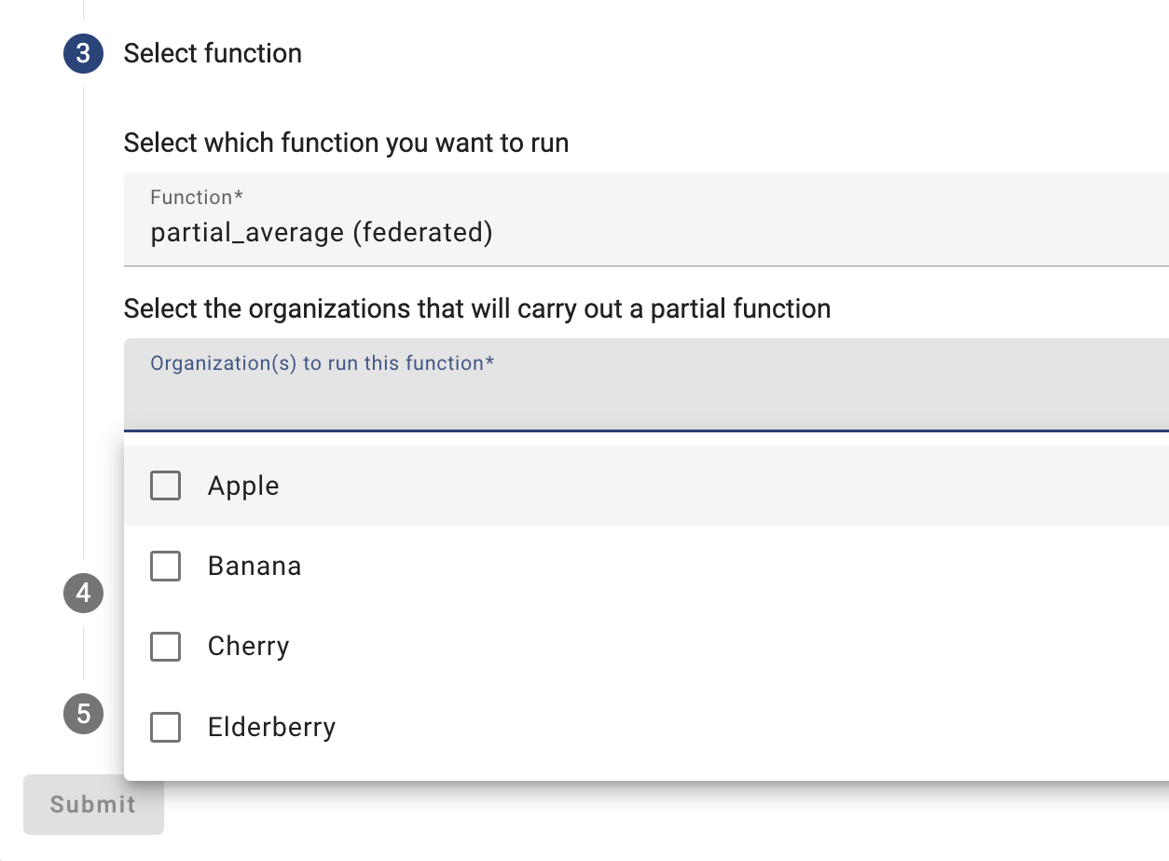
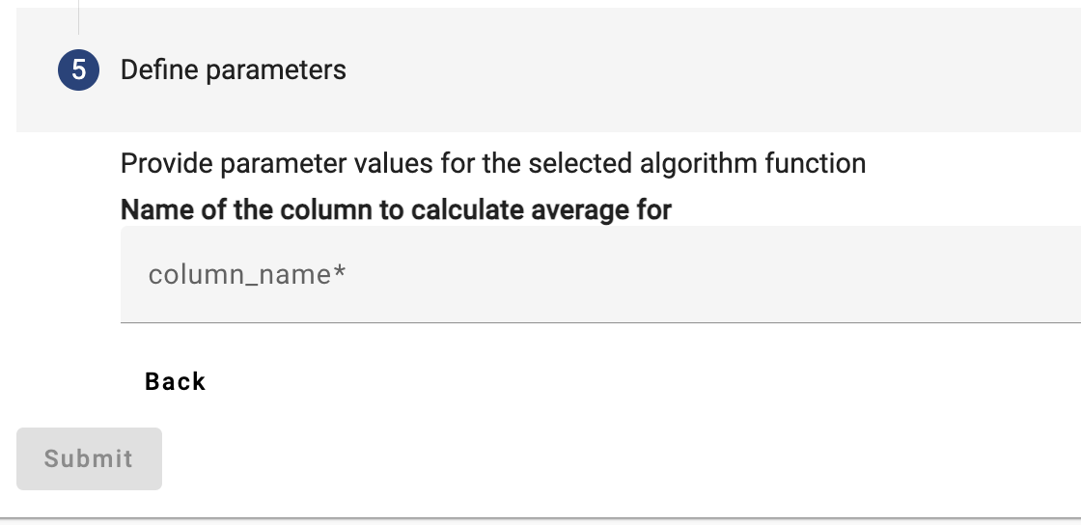
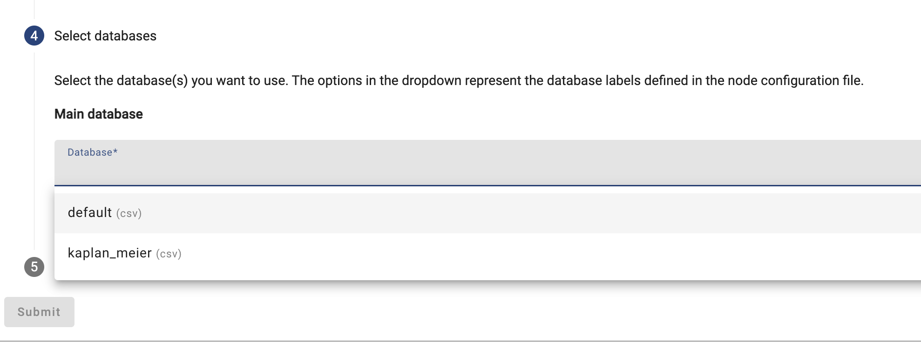
Running a federated algorithm
SOLUTION

Slide 17
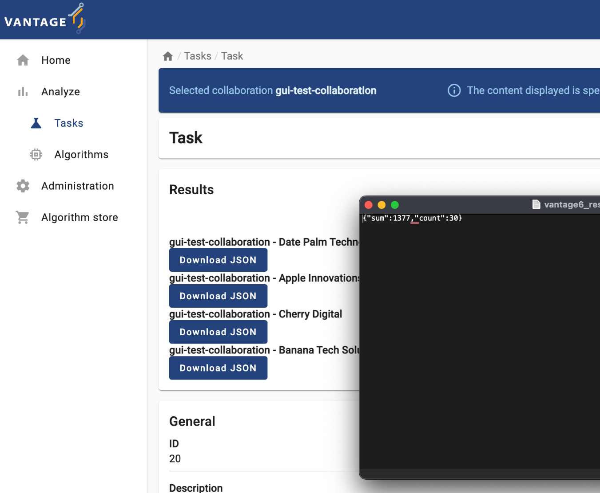
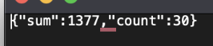
Getting familiar with the UI
SOLUTION
The partial_average returns the two values needed by the central function of the ‘federated average’ algorithm, as described in Chapter 2: the number of records within the database, and their sum.
The algorithm is ‘encoding’ these values as a JSON document, so they can used later (e.g., by another function or program).

Slide 18
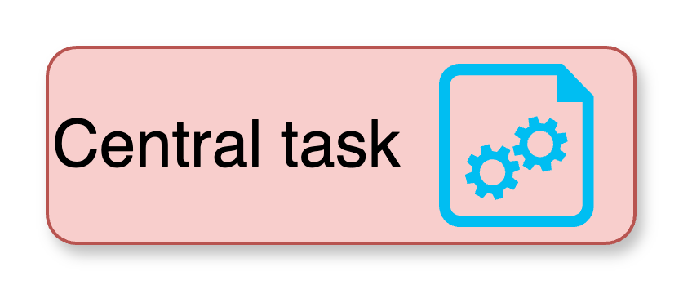
Running a PET: federated analysis
Federated
Average
Let’s create yet another task.
This time you will run the central_average function, of the Federated Average algorithm, on one of the study nodes (once again, on the study with no offline nodes).
central_avg()
partial_avg()
Task request
(central_average)
@Elderberry.
Algorithm store

Slide 19
Running a federated algorithm
CHALLENGE 4
Let’s see what the central function does under the hood!
Use the study with no offline nodes.
Choose the Average algorithm.
Select the central_average function and one of the organizations within the study.
Choose the default database.
Choose a numerical variable as the input.
Keep an eye on the Tasks section, and see how the processes are created:
Why does one of the nodes show up as a Main process and also as a Child one?
HINT As soon your task is created, go to the task list and open it. See how ‘child processes’ are created.
Notes:
Show how you can check which taks and on which nodes were created afterwards

Slide 20
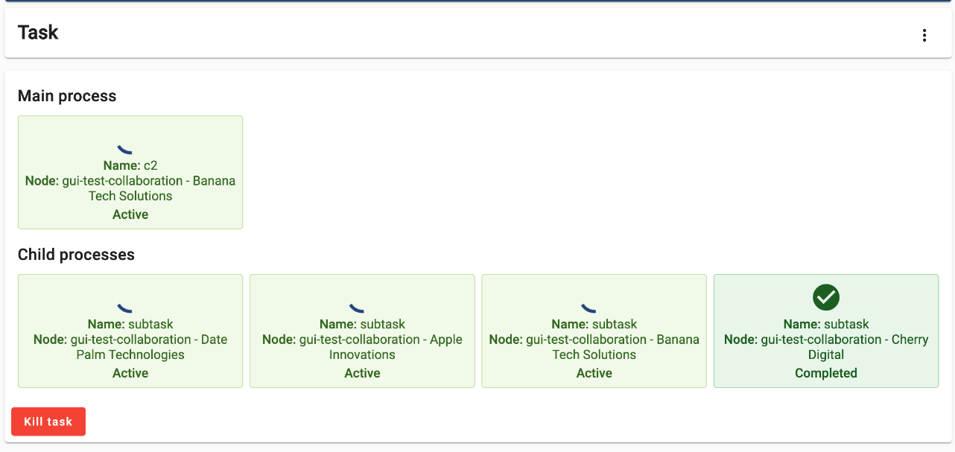
Running a federated algorithm
CHALLENGE 4
Why does one of the nodes show up as a Main process and as a Child one?
!
!
Notes:
Show how you can check which taks and on which nodes were created afterwards

Slide 21
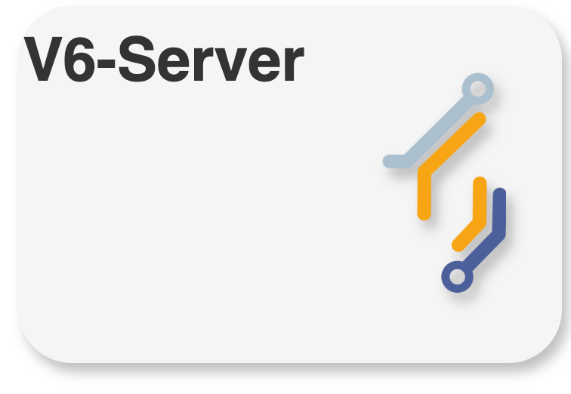
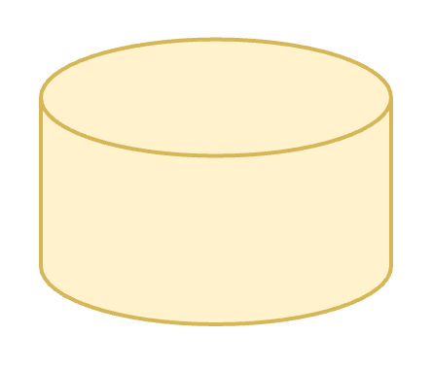
Algorithm pseudo-code
CHALLENGE 4
FUNCTION partial_average(dataset, column_name)
1 INFO("Extracting column”, column_name)
2 column_values = dataset[column_name]
3
4 INFO("Computing partials")
5 local_sum = SUM(column_values)
6 local_count = SIZE(column_values)
7
8 RETURN {"sum": local_sum, "count": local_count}
END FUNCTION
FUNCTION central_average(client, column_name)
study_orgs = client.study.list()
2
3
4 INFO("Requesting partial computation")
5 task = client.task.create(
6 function = "partial_average"
7 column = column_name
8 organizations = study_orgs
9 )
10
11 INFO("Waiting for results")
12 results = client.wait_for_results(task)
13
14 global_sum = 0
15 global_count = 0
16
17 FOR EACH output IN results
18 global_sum = global_sum + output.sum
19 global_count = global_count + output.count
20
21 average = global_sum/global_count
22
23 RETURN {"average": average}
END FUNCTION
HINT
client
Why does one of the nodes show up as a Main process and also as a Child one?
Actual python code?
https://bit.ly/v6-federated-avg
dataset

Slide 22
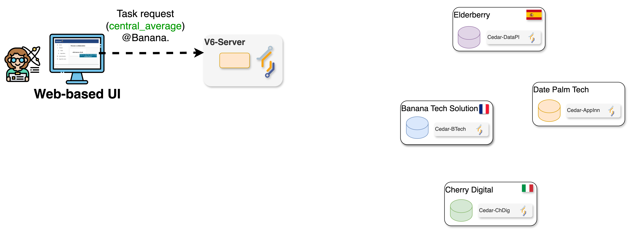
Getting familiar with the UI
SOLUTION
The Task with the central_average function, when executed by a node, requests all the nodes within the Study to run the partial_average one. This particular node is also part of the Study, so in the end it gets his own request!
!
!

Slide 23
Revisiting key concepts…
FUNCTION partial_average(dataset, column_name)
1 INFO("Extracting column”, column_name)
2 column_values = dataset[column_name]
3
4 INFO("Computing partials")
5 local_sum = SUM(column_values)
6 local_count = SIZE(column_values)
7
8 RETURN {"sum": local_sum, "count": local_count}
END FUNCTION
FUNCTION central_average(client, column_name)
study_orgs = client.study.list()
2
3
4 INFO("Requesting partial computation")
5 task = client.task.create(
6 function = "partial_average"
7 column = column_name
8 organizations = study_orgs
9 )
10
11 INFO("Waiting for results")
12 results = client.wait_for_results(task)
13
14 global_sum = 0
15 global_count = 0
16
17 FOR EACH output IN results
18 global_sum = global_sum + output.sum
19 global_count = global_count + output.count
20
21 average = global_sum/global_count
22
23 RETURN {"average": average}
END FUNCTION
client
dataset
Why does the central_average function, unlike partial_average, not get any dataset as an input?
Why does the partial_average function, unlike central_average, not get any client as an input?

Slide 24
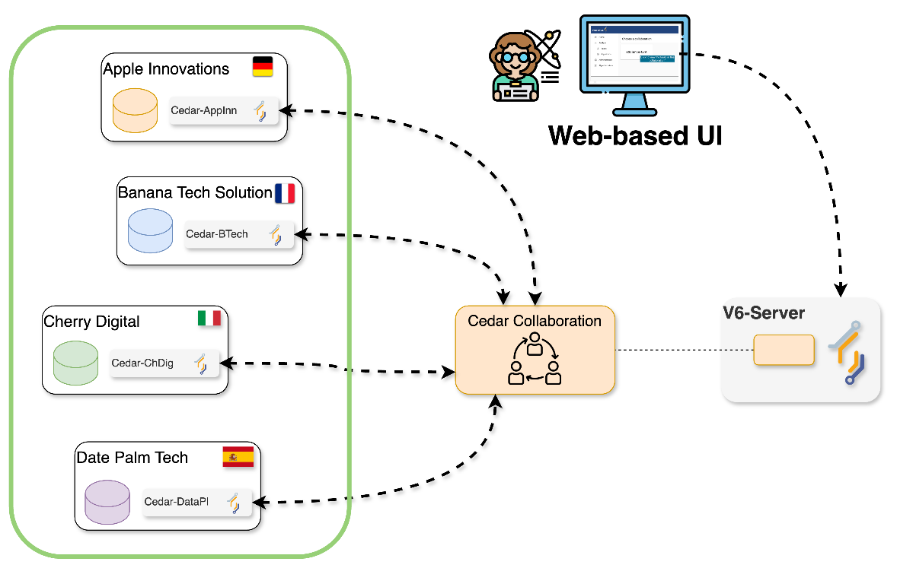
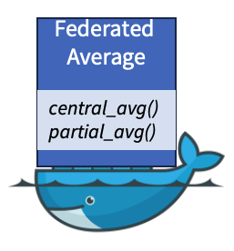
Running a PET: federated analysis
Problems on a node?
What if…
You run the central_average function (Federated Average algorithm), on the study that has an offline node?
Create a new task!
Federated
Average
central_avg()
partial_avg()
Algorithm store

Slide 25
Running a federated algorithm
CHALLENGE 5
FUNCTION central_average(client, column_name)
study_orgs = client.study.list()
2
3
4 INFO("Requesting partial computation")
5 task = client.task.create(
6 function = "partial_average"
7 column = column_name
8 organizations = study_orgs
9 )
10
11 INFO("Waiting for results")
12 results = client.wait_for_results(task)
13
14 global_sum = 0
15 global_count = 0
16
17 FOR EACH output IN results
18 global_sum = global_sum + output.sum
19 global_count = global_count + output.count
20
21 average = global_sum/global_count
22
23 RETURN {"average": average}
END FUNCTION
handling problems through the UI!
Use the study that has an offline node.
Choose the Average algorithm.
Select the central_average function and an online organizations within the study.
Choose the default database.
Choose a numerical variable as the input.
What happened with the task? Why?
HINT

Slide 26
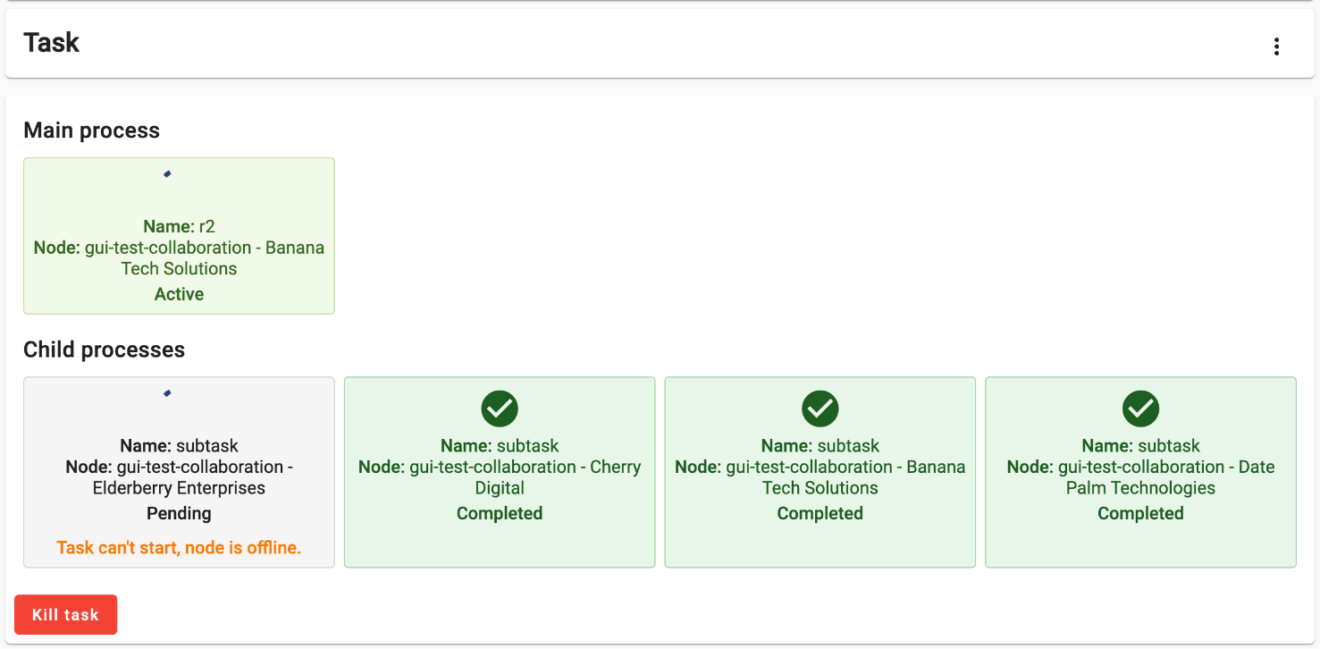
Getting familiar with the UI
SOLUTION
The algorithm didn’t crash.
The Central task requests all the nodes in the study to run the ‘partial’ function. As the server is unable to transfer this request to the offline node, this child process is kept on hold, until the node is back online.
Consequently, the Main process is also kept on hold, and the process stays with an ‘Active’ status indefinitely (or until the node is back online).

Slide 27
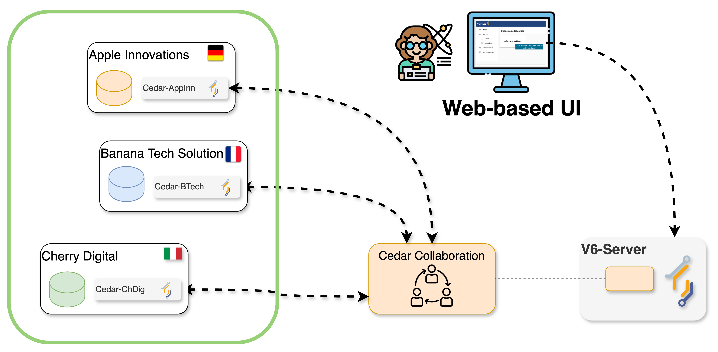

Running a PET: federated analysis
Problems at the code level?
What if…
You run the central_average function (Federated Average algorithm), and later on a node gets a runtime error? (e.g., a code bug, unexpected input, etc.)
Create a new task!
Federated
Average
central_avg()
partial_avg()
Algorithm store

Slide 28

Running a federated algorithm
CHALLENGE 6
Handling problems through the UI!
Use the study that has no offline nodes.
Choose the Average algorithm.
Select the central_average function and one of the organizations within the study.
Choose the default database.
Choose the ageGroup variable as the input.
Look at the error logs.
What was the cause of the failure of the partial_average? What about the central_average?
HINT The error logs contain the error messages generated by the Python interpreter while running the algorithm functions. Look for messages that hint the root cause of the problem.

Slide 29
Running a federated algorithm
CHALLENGE 6
FUNCTION central_average(client, column_name)
study_orgs = client.study.list()
2
3
4 INFO("Requesting partial computation")
5 task = client.task.create(
6 function = "partial_average"
7 column = column_name
8 organizations = study_orgs
9 )
10
11 INFO("Waiting for results")
12 results = client.wait_for_results(task)
13
14 global_sum = 0
15 global_count = 0
16
17 FOR EACH output IN results
18 global_sum = global_sum + output.sum
19 global_count = global_count + output.count
20
21 average = global_sum/global_count
22
23 RETURN {"average": average}
END FUNCTION
FUNCTION partial_average(dataset, column_name)
1 INFO("Extracting column”, column_name)
2 column_values = dataset[column_name]
3
4 INFO("Computing partials")
5 local_sum = SUM(column_values)
6 local_count = SIZE(column_values)
7
8 RETURN {"sum": local_sum, "count": local_count}
END FUNCTION
HINT
Look at the error logs. What was the cause of the failure of the partial_average? What about the central_average?
HINT

Slide 30
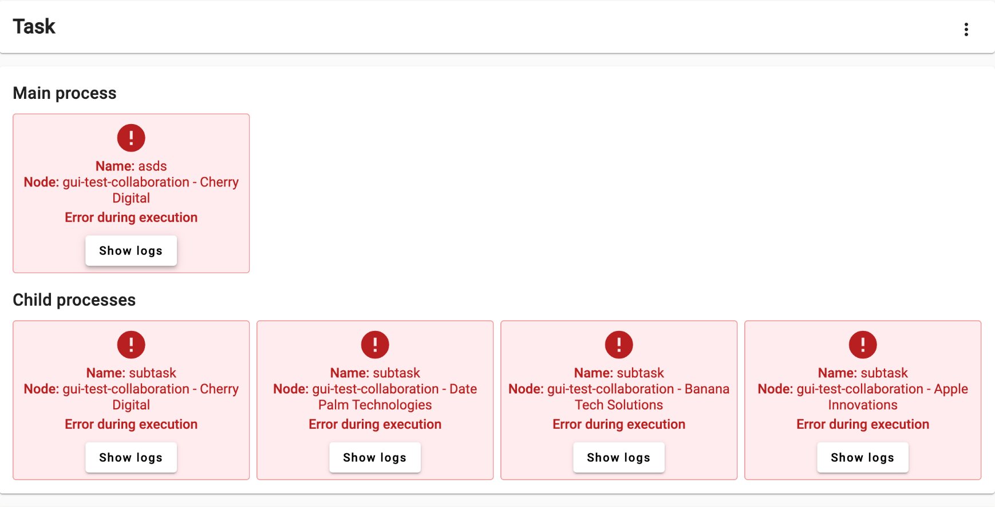
Getting familiar with the UI
SOLUTION
This time, the partial_average function on all the data nodes crashes, which lead to the failure of the Main process (central_average).
The partial_average crashed while trying to parse the input as a number. The central_average crashed due to a division-by-zero.

Slide 31
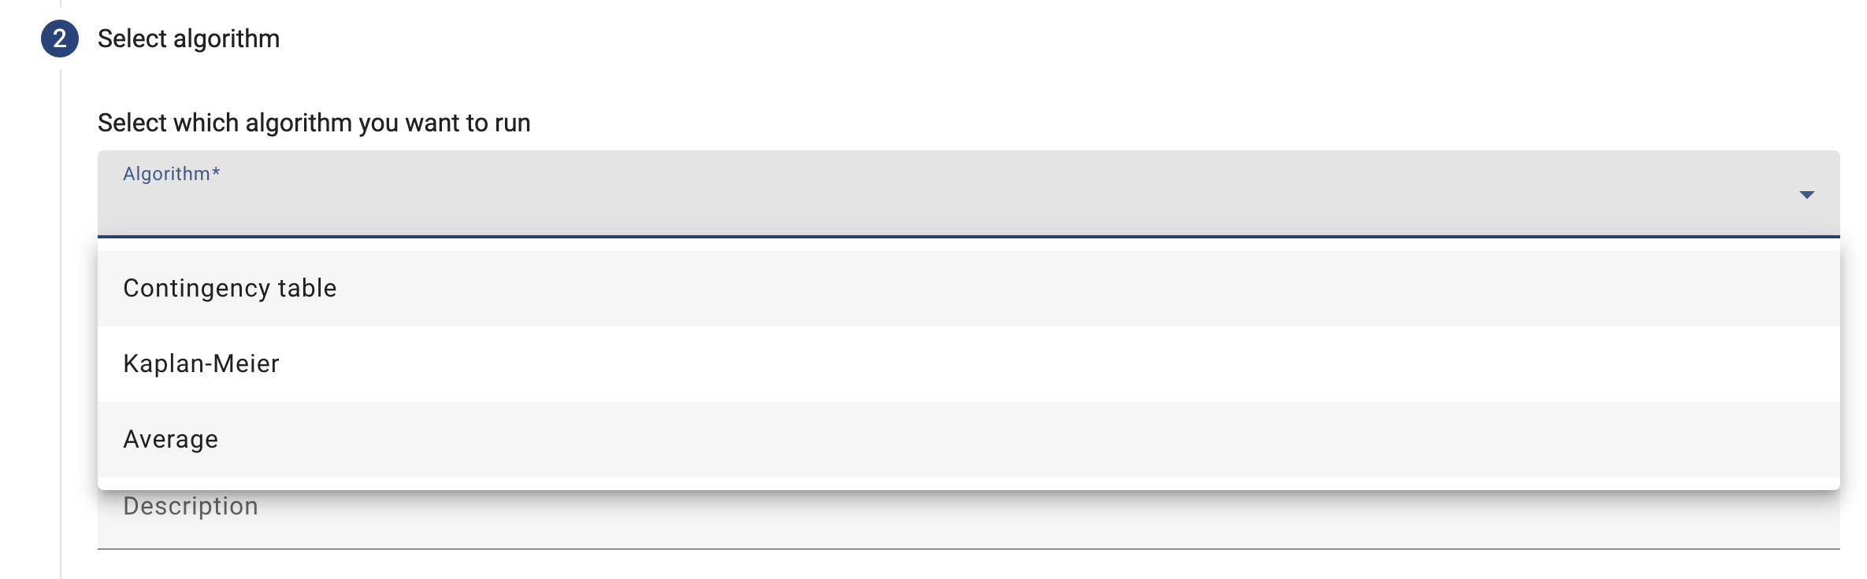
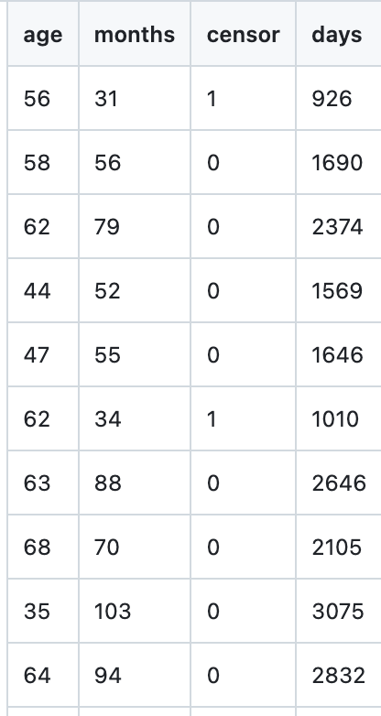
Play around with other algorithms
CHALLENGE 7
Try to run other (more advanced) algorithms!
HINT For Kaplan-Meier, choose the kaplan_meier (csv) database!

